Slide 1

Expense Management System
User friendly web application for expense management
Batch 2 :
Suhas Shinde
Arpit Sharma
Arul G
H Yashwanth
Harish Murali

Slide 2
Abstract
Overview :
An Expense Management System streamlines the process of tracking, managing, and analyzing personal or business expenses. It provides users with tools to categorize expenses, set budgets, and generate reports, enabling better financial planning and control. With features like secure data storage and real-time analytics, the system enhances efficiency and helps in maintaining accurate financial records.
Key Features :
- Expense Tracking: Record and categorize expenses for better visibility.
- Budget Management: Set and monitor budgets to control spending.
- Reporting and Analytics: Generate reports to analyze spending patterns.
- Receipt Management: Upload and manage receipts for easy tracking.
- Multi-Currency Support: Manage expenses in various currencies for global use.

Slide 3
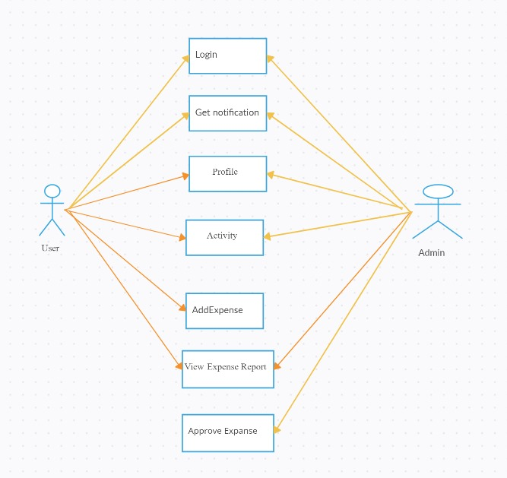
Use case Diagram

Slide 4
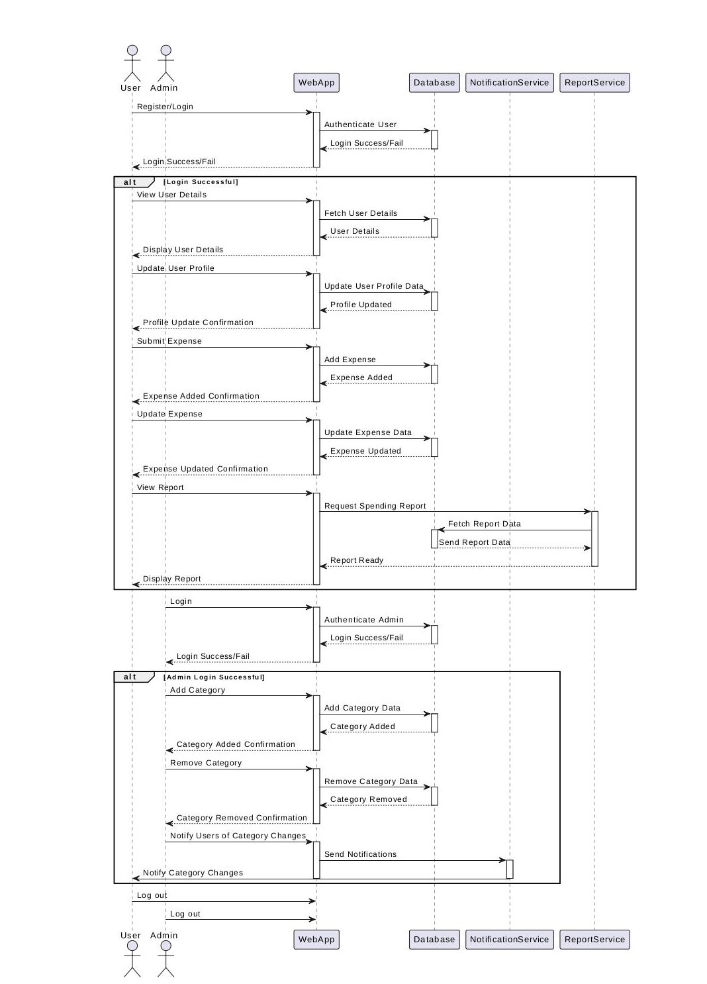
Sequence Diagram

Slide 5
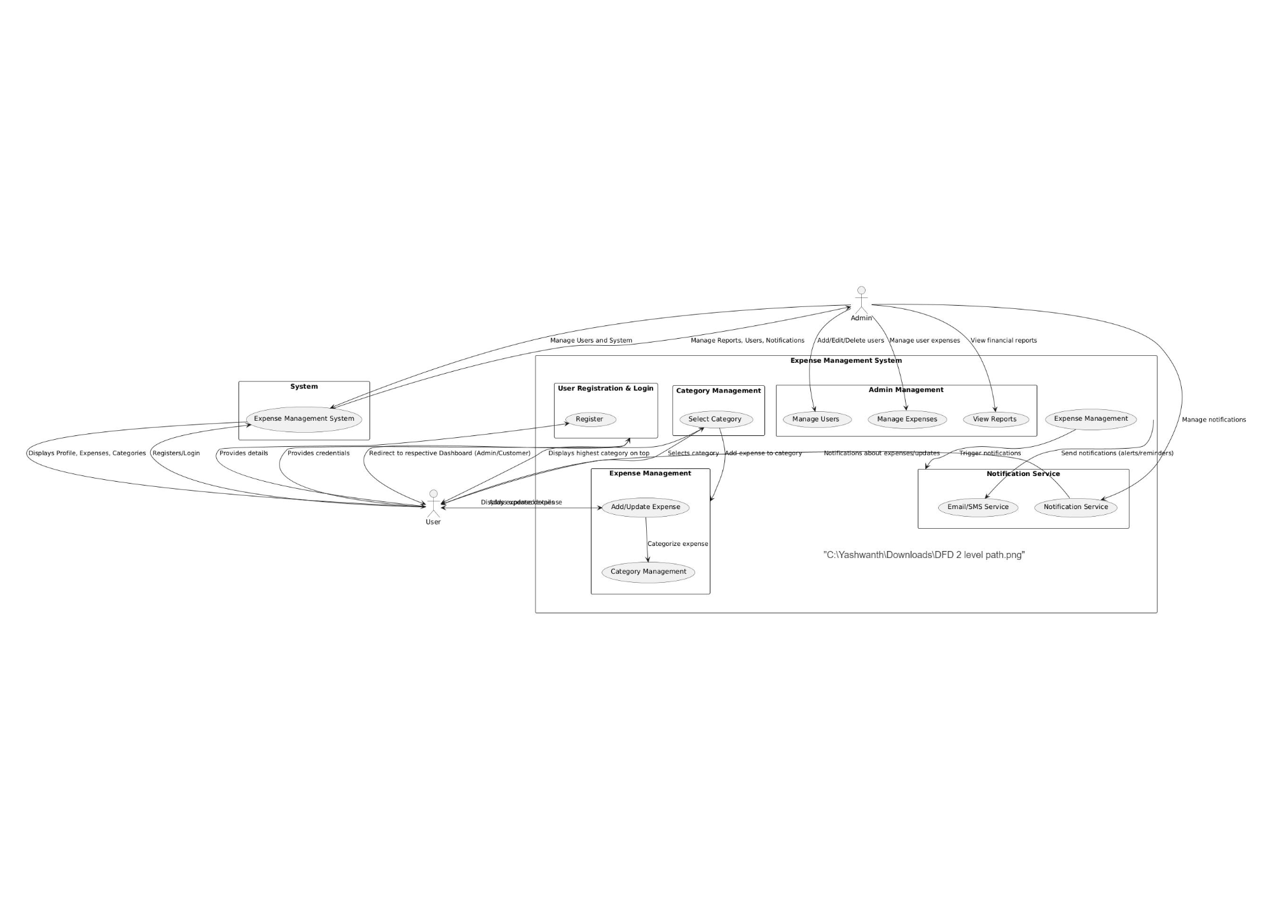
Data Flow Diagram

Slide 6
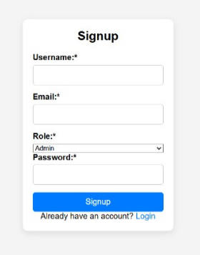
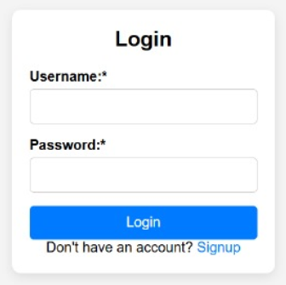
Form design

Slide 7
Benefits of the Expense Management System
Improved Accuracy
Enhanced Efficiency
Increased Financial Control
Automated expense tracking reduces manual errors and ensures data accuracy.
Streamlined workflows and automated processes save time and effort.
Real-time visibility into spending patterns allows for better budget management.
Employees can focus on core tasks, boosting productivity.
This leads to more reliable financial reports and insights.
Proactive adjustments can be made to optimize finances.

Slide 8

Future Enhancements
1
Integration with Accounting Software
Seamlessly connect the expense management system to popular accounting platforms, automating data transfer and streamlining financial workflows.
2
Advanced Reporting and Analytics
Enhance reporting capabilities with advanced visualizations and data analysis tools, providing deeper insights into spending patterns and trends.
3
AI-Powered Expense Categorization
Implement machine learning algorithms to automate expense categorization, reducing manual effort and improving accuracy.
4
Mobile App Optimization
Enhance the mobile app with user-friendly features, improved navigation, and offline functionality, providing users with convenient expense tracking on the go.

Slide 9

Conclusion
In conclusion, an Expense Management System is essential for individuals and businesses seeking to enhance their financial oversight. By providing tools for tracking expenses, managing budgets, and generating insightful reports, it empowers users to make informed financial decisions. Ultimately, this system promotes better financial discipline, helping to ensure long-term financial stability and success.

